Slide 1
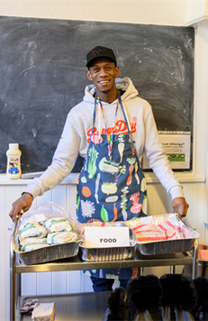
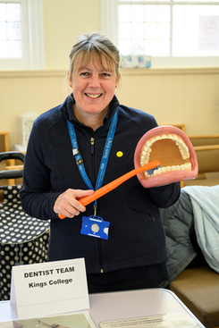
www.spearlondon.org

Slide 2
About Us
SPEAR is a local homelessness charity delivering services to people experiencing homelessness in
South West London.

Slide 3
independence
COMMUNITY DEVELOPMENT
ROUGH SLEEPER OUTREACH
HOMELESS
HEALTH LINK SERVICE
homelessness
ACCOMMODATION

Slide 4
Rough Sleeper Outreach
The Outreach teams go out at night and in the early morning to verify people sleeping rough – providing pathways and support to assist people off the streets.
SPEAR then assists them to link into various support services, tailored to the challenges an individual might face.
The Outreach teams also have navigators, who work with people who may have complex needs or are particularly entrenched in the street homeless lifestyle.

Slide 5
IF YOU SEE SOMEONE NEEDING OUR SUPPORT, PLEASE GO TO
WWW.THESTREETLINK.ORG.UK

Slide 6
SPEAR Services in RBK
Kingston – Outreach Team
Team of 4 workers
Kingston Resettlement Team
St Johns Lodge (SJL)- 4 beds
292 Kingston Road- 6 beds
(currently closed)
14 Howard Road-6 beds
(currently closed)
1 bed properties - 9 flats
There is no pathway from these properties as in quotas, the move on from the above HMO's is generally to PRS.

Slide 7
Accommodation
Permanently staffed hostels
Houses of Multiple Occupancy
Private Rented Accommodation
Young people’s hostel
Clients can enter at any level based on their clinical needs.
The different levels provide a clear pathway for those most in need.

Slide 8
Current challenges
With the increasing prices, people are having to make difficult choices on spending priorities leading to rent or mortgage arrears.
As the need for services increases, people’s budgeting will reduce donations.
A recent survey indicated that 14% of people plan to reduce charity giving.

Slide 9
Nationally
CURRENT ROUGH SLEEPING SITUATION UK
(LATEST DATA)
7,236 people were counted or estimated by local authorities to be sleeping rough in England over the month of June 2023
This represents a 15% increase since March 2023, and up 1,668 people or 30% since the same period last year.
Data gathered from “street counts” and estimations provided by local authorities nationally
Is a ‘best guess’ and the true number is likely to be higher

Slide 10
LONDON
2086 Rough Sleepers recorded in Q2 23/24
Westminster recorded 748 alone
Data drawn from CHAIN database showing Outreach interactions with rough sleepers
Data closer to reality than nationally but still not capturing everything
KINGSTON
Total recorded in quarter - 40
New Rough Sleeper - 11
Intermittent - 23
Living On the Street (LOS) - 6

Slide 11
Gary Clements, Operations Manager, Outreach
Jude Everett – Team Leader, Kingston Outreach
Charity number: 1122206
89 Heath Road, Twickenham, TW1 4AW

